Slide 1

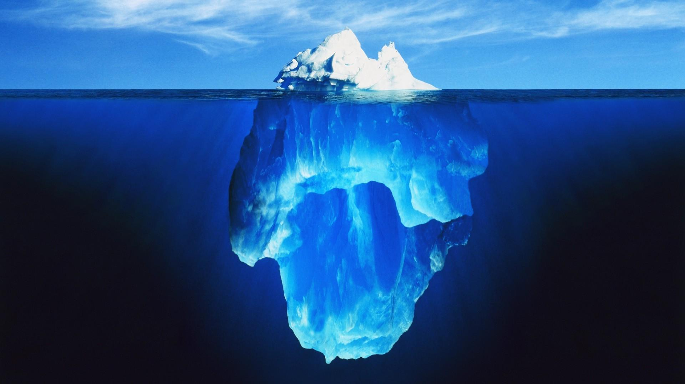
Quick introduction on interactive R:
DNF Coding club 06.11.2019
Adrian c lo
Shiny
R code

Slide 2
Purpose of this introduction
YES:
Philosophy of Shiny
General framework
Examples
“Certificate” of attendance
NO:
Learn specific commands, functions, etc.
After this introduction: expert Shiny apps developer
“Certificate” of Shiny competence

Slide 3
Definition of SHIny (from the developers)
Shiny is an open source R package that provides an elegant and powerful web framework for building web applications using R.
Shiny helps you turn your analyses into interactive web applications without requiring HTML, CSS, or JavaScript knowledge.

Slide 4
Definition of SHIny (from the developers)
Shiny is an open source R package that provides an elegant and powerful web framework for building web applications using R.
Shiny helps you turn your analyses into interactive web applications without requiring HTML, CSS, or JavaScript knowledge.

Slide 5
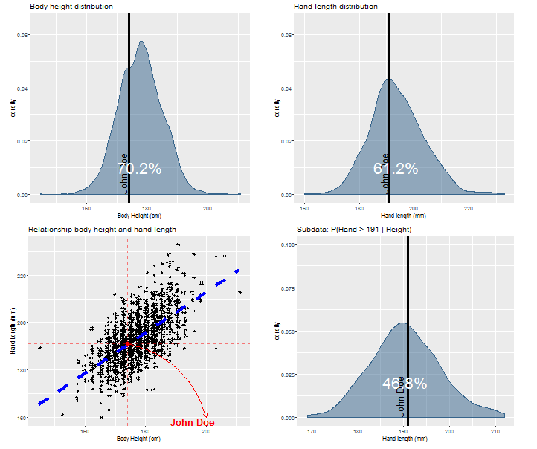
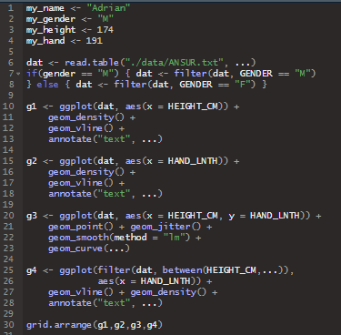
Example: are your hands in proportion with your height? R version
input
R code
R output
DISADVANTAGES
(R knowledge)
Code input
No interactivity

Slide 6
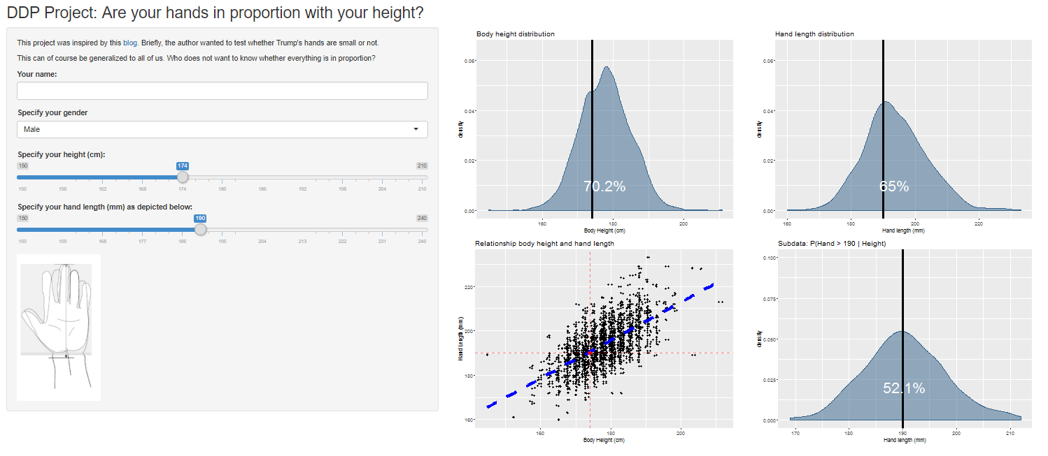
Example: are your hands in proportion with your height? Shiny version (Snapshot)

Slide 7
Example: are your hands in proportion with your height? Shiny version
DEMONSTRATION
Notes:
https://adrianclo.shinyapps.io/DDP_App/

Slide 8
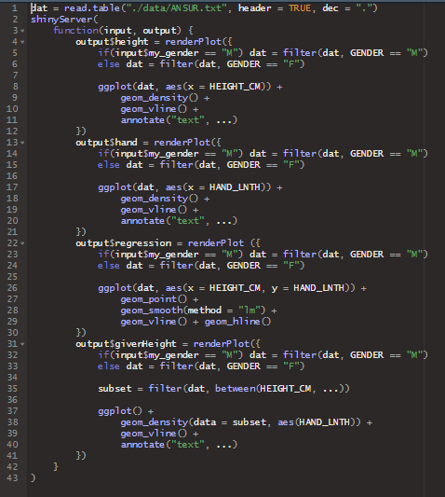
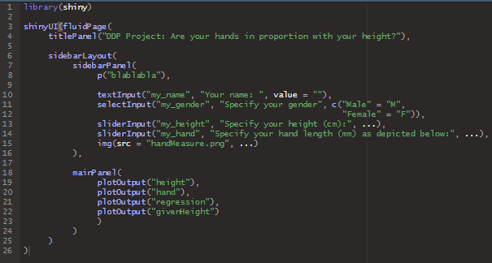
Shiny anatomy
server.R
(processor/machinery)
ui.R
(user interface)
Wrapper function
Interactive input
Updated output

Slide 9
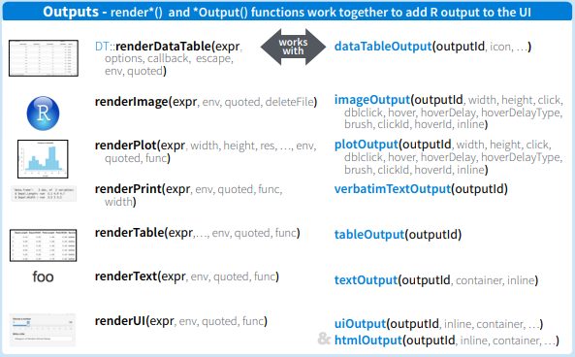
SHINy logic
INPUT:
*Input and *Button(s)
OUTPUT:
render* and *Output

Slide 10
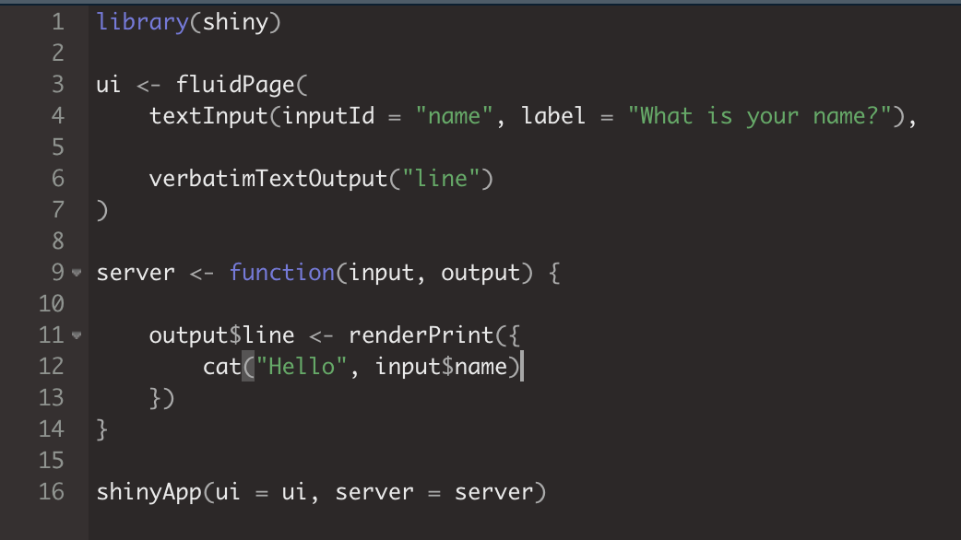
SHINY Hello world
LET’S PLAY

Slide 11
Applications
For fun / exploration:
https://adrianclo.shinyapps.io/DDP_App/ (Trump’s hand-height)
https://dreamrs.shinyapps.io/memory-hex/
https://shiny.rstudio.com/gallery/word-cloud.html
Web scraping / Database access:
http://gliovis.bioinfo.cnio.es/ (Visualizing brain tumor datasets)
https://gadenbuie.shinyapps.io/tweet-conf-dash/_w_5c51d691/# (Twitter conference)
https://nsgrantham.shinyapps.io/tidytuesdayrocks/ (TidyTuesday)
Visualization aids:
https://huygens.science.uva.nl/PlotsOfData/
https://asntech.shinyapps.io/intervene/ (Venn diagrams)
Data processing:
https://schultzelab.shinyapps.io/Shiny-Seq/ (RNA-seq)
colcr (Co-localization analysis on fluorescence microscopy images)
https://karolcichewicz.shinyapps.io/shinyr-dam/ (Shiny-DAM)
Notes:
colocr: https://peerj.com/articles/7255.pdf

Slide 12
Further reading
https://shiny.rstudio.com/tutorial/ (Online tutorial)
Building web applications in R with Shiny: Case studies (Online course: www.datacamp.com)
Building dashboards with shinydashboard (Online course: www.datacamp.com)
Cheat sheet (https://shiny.rstudio.com/images/shiny-cheatsheet.pdf)
Learning Shiny (Hernán G. Resnizsky)
Web application development with R using Shiny (Chris Beeley)

Slide 13
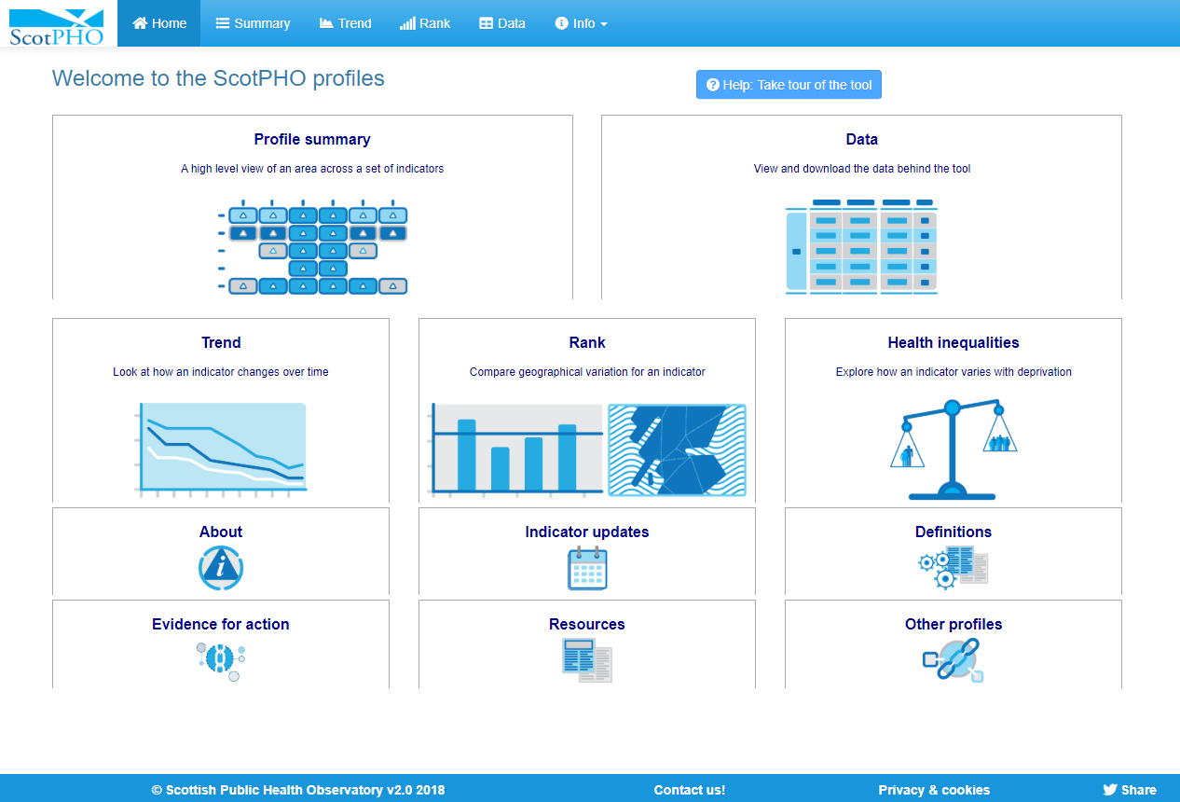
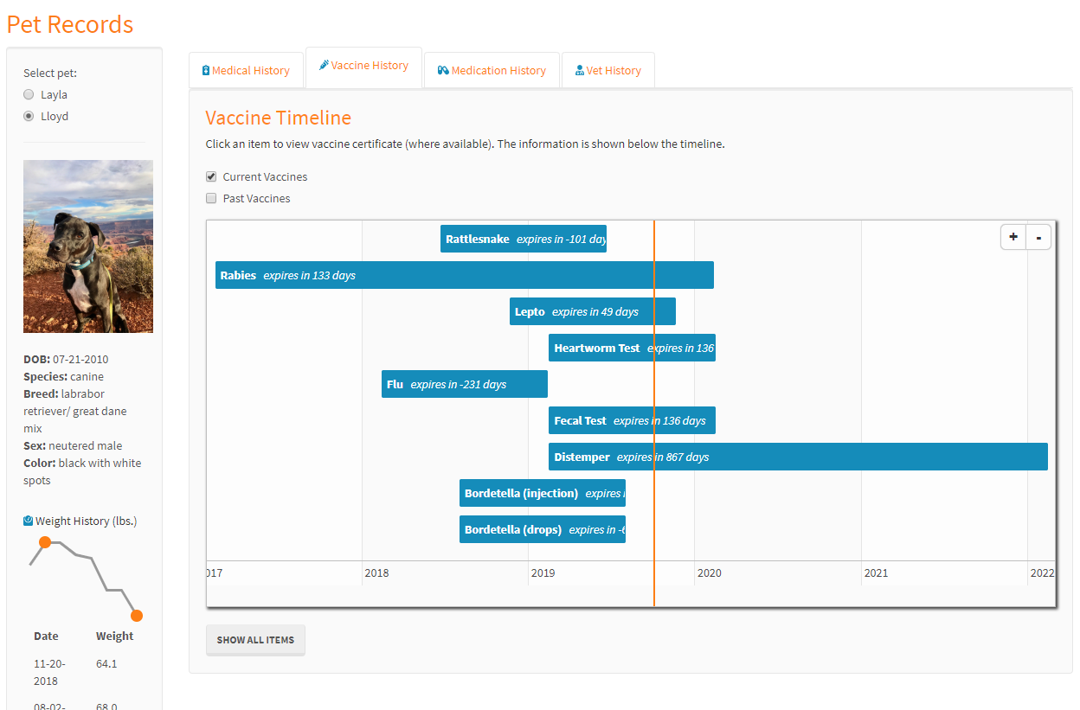
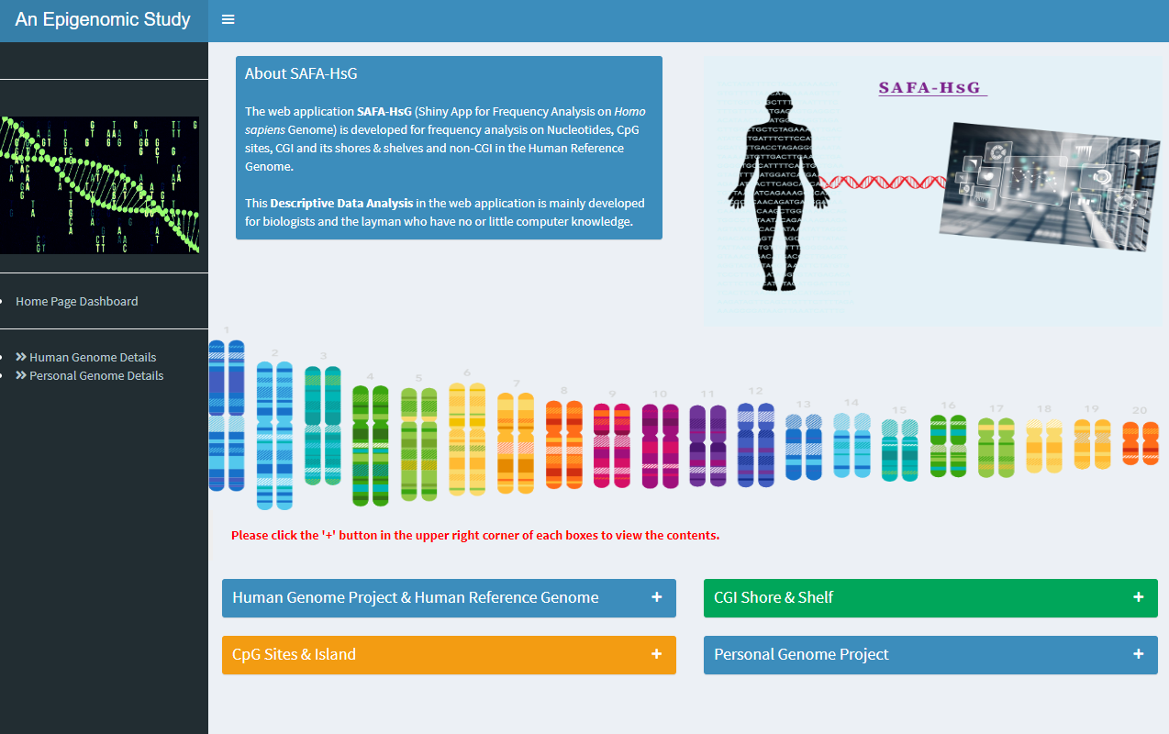
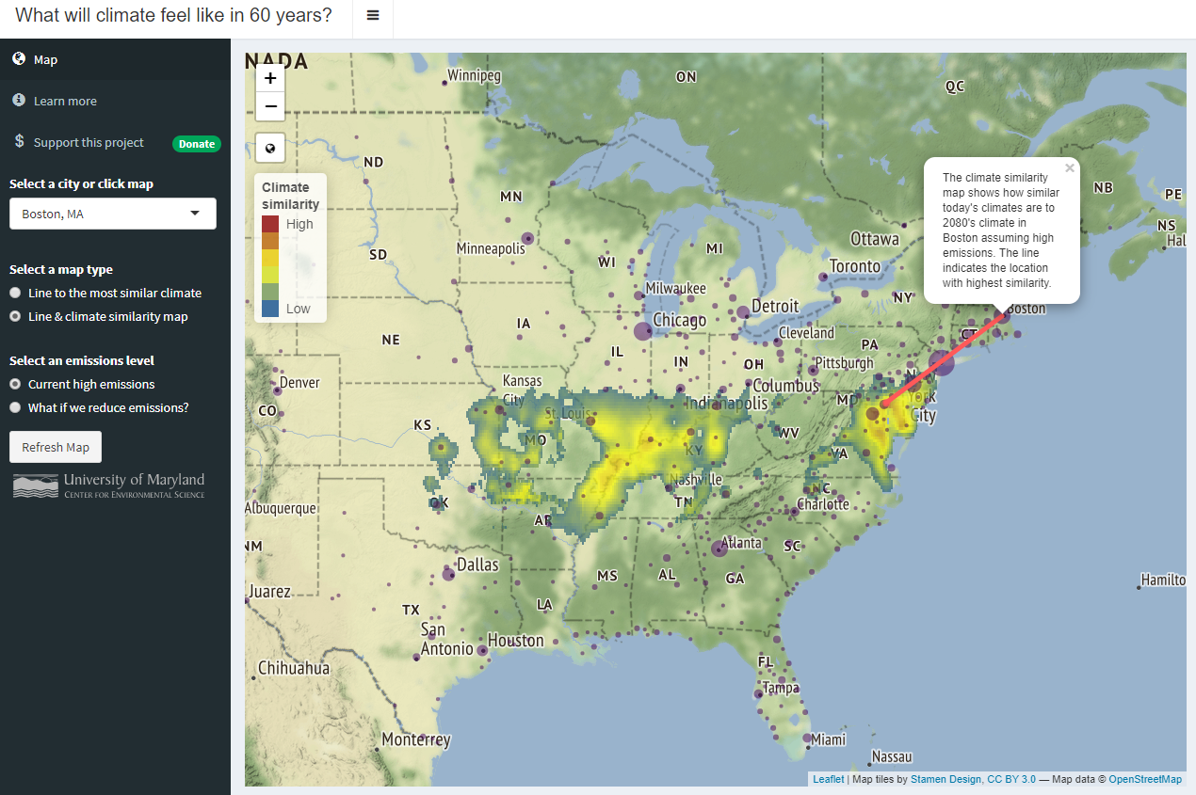
EXTEND WITH htmL / CSS / JavaScript

Slide 14
DEPLoy
Launch app online
shinyapps.io
Free Plan: 5 running apps; 25 active hours per month; publicly available
Standard Plan: unlimited (private) apps; 2000 active hours per month
Own server
App remains offline (desktop / NAS)
App has to be launched through RStudio.
Go to “App folder” > select “ui.R” or “server.R” > Click “Run App” > Good to go!

Slide 15
